Slide 1
Thesis

Slide 2
Greek for “Perspective”
the·sis
ˈTHēsis/
noun
noun: thesis; plural noun: theses
1.
a statement or theory that is put forward as a premise to be maintained or proved.
"his central thesis is that psychological life is not part of the material world"
synonyms:theory, contention, argument, line of argument, proposal, proposition, idea, claim, premise, assumption, hypothesis, postulation, supposition "the central thesis of his lecture"

Slide 3
Elements of a Good Thesis
1. Narrow Topic
2. Opinion
3. Purpose
4. Parts

Slide 4
1. Narrow Topic
Make sure to make your topic small enough so that you can develop it in 2.5-3 pages
Example: Health
Food
Coffee
Starbucks

Slide 5
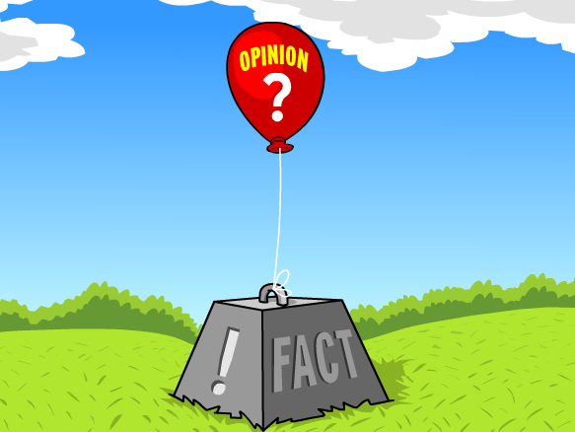
2. Opinion
Make sure your thesis has an opinion not a fact that everyone would agree with.
Example:
Fact: Starbucks is a very popular coffee shop for college students.
Opinion: Starbucks is an unhealthy choice for college students.

Slide 6
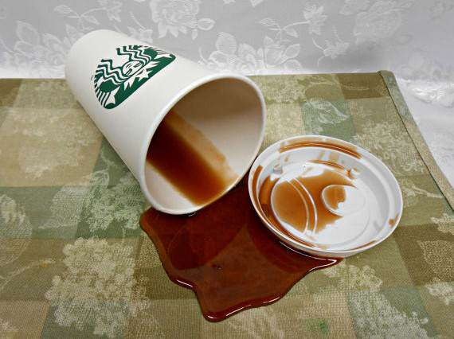
3. Purpose
Make sure each thesis is clearly showing the reason why it’s important to know this information. Sometimes the purpose is implied more than stated directly
Example: Persuade my fellow De Anza classmates to avoid drinking Starbucks

Slide 7
4 Parts
List the evidence you will use to support your thesis.
This is like a road map for the rest of the essay.
Each item on the list will represent one body paragraph
Example:
1. High Sugar Content
2. Processed Baked Goods
3. Too much Caffeine

Slide 8
Put it all together
Starbucks is an unhealthy choice for college students because of it’s sugar, processed foods, and caffeine.

Slide 9
Practice
You try!
Choose one of the following topics
1. Narrow the topic, 2. make an opinion 3. suggest the purpose 4. add the parts
Food
Exercise
Dieting
Alcohol
Sleep
Stress

Slide 10
Introductions
Introductions are the first impression of your essay. They are key to giving the reader interest and background to your topic and they set up your thesis.

Slide 11
PRACTICE
Each group will receive one introduction strategy from the READER.
Write an introduction for the Starbucks thesis using your strategy. 4-5 sentences.
Make the last sentence your Thesis
“Starbucks is unhealthy because of sugar, high processed foods, and caffeine.”

Slide 12
Titles
Like your introductory paragraph, the title should grab your readers attention and make them want to read the essay.
Have fun and get creative with the title!

Slide 13
Boring Title
“Starbucks”

Slide 14
Interesting Title
“Hot Shots and Cool Fraps: Drinks to Die For”

