Slide 1

AB 705 Presentation
October 15, 2019

Slide 2
2018-19 Pilot Phase for Math and English
Math
Summer 2018: Removed all prerequisites to MATH 10 (Statistics)
Fall 2018: Started placing students into MATH 41 (Precalculus) in the highest GPA band
Began reducing Basic Skills sections, from 116 sections in 2017-18 to five in fall 2019
Began reducing Intermediate Algebra sections, from 93 sections in 2017-18 to nine in fall 2019
English
Fall 2018: Began placing students into EWRT 1A (English 1A) using the highest GPA band
Began piloting “Bundled” courses (EWRT 1A + corequisite) and “Stretch” courses (EWRT 1A over two quarters)
Reduced Basic Skills Reading sections from 107 sections in 2017-18 to zero in fall 2019
Reduced Basic Skills EWRT sections from 104 sections in 2017-18 to one in fall 2019

Slide 3
Access and Enrollment
+856 enrollments over prior year
+1,326 enrollments over prior year
Excludes summer terms. EWRT 1A includes courses linked to LART 20 sections. MATH 10 Includes all MATH 10 sections.
Notes:
In the past three years, overall enrollment has been declining. But with these changes, we see a large jump from 2017-18 to 2018-19 – a 23% increase, or an additional 856 students, in EWRT 1A enrollment; and a 43% increase, or an additional 1,326 students, in MATH 10 enrollment.

Slide 4
Successful Completions
+601 additional successful completions
+667 additional successful completions
Excludes summer terms. EWRT 1A includes courses linked to LART250 sections. MATH 10 includes all MATH 10 sections. Successful completion is grade of A, B or C.
Notes:
As enrollment decreased, the number of successful completions had also decreased. But with the increase in enrollment in fall 2018, there was an increase in successful completion, as well. For EWRT1A the increase was 21% or 601 additional completions. For Math it was a 31% increase or 667 more successful completions.
Success rates for EWRT 1A remained stable at 77% in 2018-19. Success rates for MATH 10 dropped a few percentage points but remained fairly stable, compared to the prior four years, at 64%.

Slide 5
Additional Enrollments by Ethnicity
Comparing 2017-18 to 2018-19
Excludes summer terms. EWRT 1A includes courses linked to LART 250 sections. MATH 10 Includes all sections of MATH10. Native American, Pacific Islander, Filipinx, and Unknown not plotted.
Notes:
The gaps in enrollment continue to persist between African American and White and Latinx and Asian students, but the sheer volume of students who enroll in transfer-level courses has grown exponentially, with the largest gains seen for Latinx students in MATH 10. Keep in mind that, in prior years, enrollment had declined for all ethnic groups.
The growth was greatest for Asian (30%) and Latinx (28%) students in EWRT1A and for LatinX (74%) and African American (70%) students in MATH10.
For EWRT the growth for Asian student enrollment was 30%, Latinx was 28%, African American was 14% and White was 10%. For MATH10 the growth was 74% for Latinx, 70% for African American, 32% for White and 26% for Asian.

Slide 6
Additional Successful Completions by Ethnicity
Comparing 2017-18 to 2018-19
Excludes summer terms. EWRT 1A includes courses linked to LART 250 sections. MATH 10 includes all sections of MATH 10. Native American, Pacific Islander, Filipinx, and Unknown not plotted.
Notes:
The largest gains in EWRT1A were seen by Asian students (27%) followed by Latinx students (22%) and African American (19%).
For MATH10 the largest gains were again for African American students (54%) and Latinx students (47%) followed by White students (29%).

Slide 7
Throughput Rates – First Time Students Starting at Any Level who Complete Transfer Level in 3 Quarters
+11 percentage points
+22 percentage points
First-time students in each fall term, starting at any level and completing any transfer level EWRT or MATH course in three terms.
Notes:
Throughput rates measure the percentage of first-time students who start at any level – whether Basic Skills or transfer – and who successfully complete a transfer-level course within three quarters. Throughput rates increased substantially for fall 2018 for both English and math. By 11% for English and 22% for Math.

Slide 8
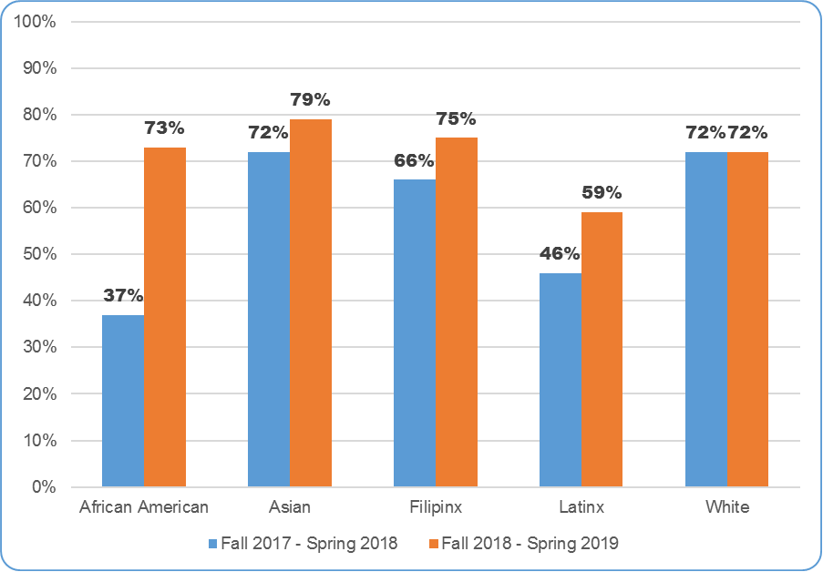
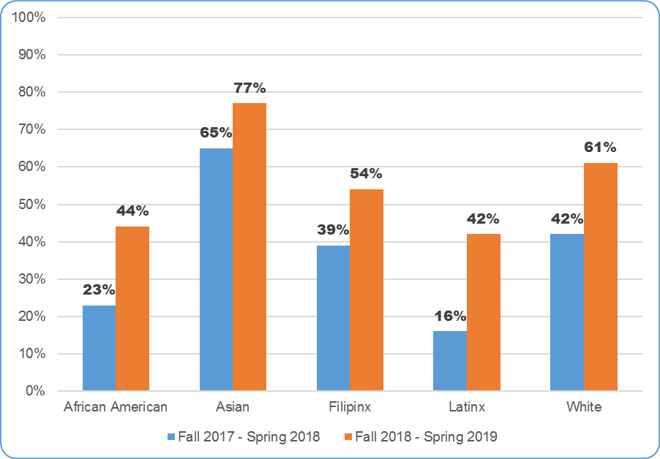
Throughput Rates – First Time Students Starting at Any Level who Complete Transfer Level in 3 Quarters – By Ethnicity
English
MATH
First-time students in each fall term, starting at any level and completing transfer-level EWRT or MATH by spring.
Notes:
Throughput rates have increased for all ethnic groups, with the largest gains for African American students – who showed a 36 percentage point improvement in EWRT 1A and 21 percentage point gain in MATH 10. The next largest gains could be seen with Latinx students, who showed a 13 percentage point gain for EWRT 1A and a 26 percentage point gain for MATH 10.
Equity gaps for EWRT 1A are lessening, with the exception of Latinx students. Equity gaps for both African American and Latinx students in MATH10 are lessening, but still remain.

Slide 9
Of students who passed MATH10 in fall 2018, what was their enrollment in other courses throughout the year compared to the prior year?
Notes:
There was an overall increase in the rate in which students were taking additional GE courses after passing MATH 10 in fall 2018, compared to the prior three fall terms, and success rates remained relatively unchanged. The highest rate of increase was in EWRT 1A, where more students took their English course after completing their math course. There were large increases in many other GE courses as well, including the next math course, MATH 41.

Slide 10
Of students who passed EWRT1A in fall 2018, what was their enrollment in other courses throughout the year compared to the prior year?
Notes:
We are even seeing increases in enrollment in other GE courses. There was an overall increase in the rate in which students were taking additional GE courses after passing EWRT 1A in fall 2018, compared to the prior three fall terms, and success rates remained relatively unchanged. The highest rate of increase was in EWRT 2, where more students took the next course in the sequence after passing EWRT 1A.

Slide 11
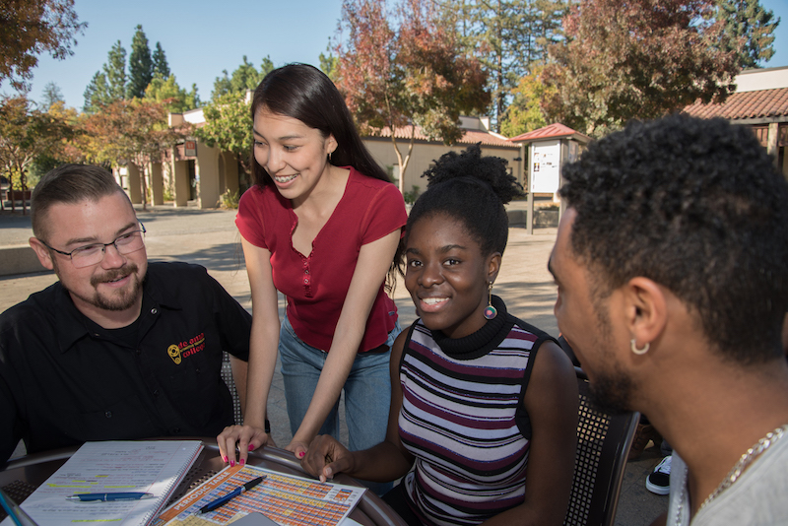
What we are doing now ...

Slide 12

Overall Changes
Students are placed primarily with high school transcript data – self-reported and actual
Guided Self-Placement is available for English and Math, when students can’t provide high school transcript data
Course sequences include corequisite supports in both English and Math
College websites, marketing, outreach materials and the catalog reflect changes to assessment and course structures – and clearly describe students’ rights to take transfer-level English and Math courses and credit ESL courses

Slide 13
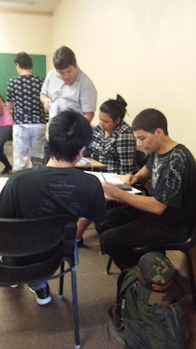
Math Department
Focused one-level below courses
Guided Self-Placement
Corequisites
The MPS program

Slide 14
Course Structures
MATH 10 (Statistics)
  High School GPA
    3.0 and Above: MATH 10 without Support (5 units)
    2.3 – 2.99: MATH 10 (5 units) + MPS or MATH 210x (5 units) support course recommended
    Below 2.89: MATH 10 (5 units) + MPS or MATH 210x (5 units) support course required
MATH 41 (Precalculus)
  High School GPA
    2.6 – 3.9 OR Below 2.6 With High School Calculus: MATH 41 with support course recommended (5 units)
    Below 2.6: MATH 41 (5 units) + MPS or MATH 231 (5 units) support course required

Slide 15
What we did…
Removed the prerequisite for Math 10 and Math 41 starting fall 2018
As concern for those who wanted to improve their skills before taking a transferrable course we developed two focused one level below transfer courses: Math 109 (pre stat) and Math 130 (pre-STEM)
To support those taking transferrable courses we developed precalculus stretch model and corequisites for Math 10, Math 11, Math 41, Math 42.
Our very successful MPS program expanded to support precalculus students in addition to Statistics students. (This was not a direct result of AB 705)
We developed and implemented a Guided Self-Placement process which went live this fall

Slide 16
Faculty Thoughts
Over the past year, our faculty team worked together to make sure the transition was as smooth and supportive for students as possible. Feedback from faculty teaching courses affected by AB 705 this fall include:
Those teaching coreq classes are very positive that extra time and review of basic concepts is helping.
Many faculty feel there is a much greater variation in student skills and background.
Some see the variation not only in academic skills but also “student-hood” issues.
Those teaching one of the two algebra classes feel students opting to take them are more motivated.
Some observed students self-correcting their self-placement by taking a lower class
Personal opinion: Faculty who teach statistics find effects of AB 705 much more positive than those teaching precalculus (STEM route).

Slide 17
English Department
Just-in-time interventions
Faculty collaboration and training
Troubleshooting
Positive attitude

Slide 18
Course Structures
AB 705 created the opportunity to work in collaboration outside of our normal silos.
Counselors, deans, staff, committees and faculty worked together to develop the best outcome for our students.
There are now three pathways in English:
High school GPA greater than or equal to 2.6 = EWRT 1A standalone
High school GPA 1.95 to 2.59: EWRT 1A “Bundled” = EWRT 1A + LART 250 (3 unit corequisite)
High school GPA less than 1.9: EWRT 1A “Stretch” = EWRT 1AS (first quarter) + EWRT 1AT (second quarter). This is a combination of EWRT 1A + 5 units of extra help
We still offer a few sections that are one level below EWRT 1A for students who wish to improve their skills before enrolling in EWRT 1A

Slide 19
Just-in-Time Interventions
Supplemental Instruction: Working together to re-envision the Writing and Reading Center (WRC) for students
Faculty and staff worked together in summer 2019 to create a menu of new directed learning activities for students. This was led by English instructor Julie Sartwell and Diana Alves de Lima and Victoria Khaler of the WRC.
The group met over the summer to brainstorm about student needs in reading and writing, then developed activities and used peer editing to perfect them.
The WRC created uniform documents and posted them on the Canvas web page.
See more here: https://deanza.instructure.com/courses/9894

Slide 20
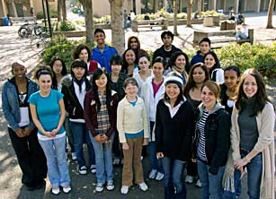
Faculty Training and Support
The annual LinC (Learning in Communities) workshop held in summer 2019 provided an opportunity to share ideas, inspiring books, curriculum and activities – and to focus on both the students as well as new EWRT 1A “Bundled” and “Stretch” courses.
The workshop theme was: Reflection and Resiliency: Rocketing our Students to Success
Elements included
    Boost with Best Practices
    Soar with Scaffolding
    Lift Off with Feedback
    Fire Up Your Students’ Success

Slide 21
Faculty Training and Support
PAGE Meetings
Monthly meetings for faculty members to discuss heartwarming moments of teaching as well as challenges, scheduling issues and plans for course offerings.
Brown Bag Lunches
Instructor Becky Roberts leads weekly meetings for “Bundled” and “Stretch” course faculty
Agenda items include:
  Our first assignments: What went well and what would we change?
  Where do students need more support?

Slide 22
Portfolios
English faculty member Brian Malone developed new portfolio expectations for EWRT 1A “Bundled” and “Stretch” courses.
  This is a work in progress that has drawn much faculty collaboration.
Faculty members engaged in several workshops to discuss expectations and contents of portfolio.
Faculty members participated in norming sessions to ensure expectations are aligned.
All faculty members teaching “Bundled” or “Stretch” EWRT 1A participate in the portfolio reading at the end of the quarter, share essay prompts and read student portfolios to determine readiness for EWRT 2.

Slide 23

Opportunities and Next Steps
Continue to work towards closing equity gaps
Support ESL department with fall 2020 implementation
Continue to evaluate and implement equitable supports
Continue to provide ongoing support and professional development to faculty and staff
Develop a comprehensive qualitative and quantitative research agenda to best understand student outcomes

Slide 24

Thank You!

