Slide 1


Student Learning Outcome Process
Update
Mary Pape
SLO/SSLO/AUO Coordinator
Visit us at deanza.edu/slo/

Slide 2
Contents
Congratulations to all faculty
Reviewing the process
Next Steps - Mapping

Slide 3
I. Accreditation
The ACCJC announced in January 2025 that it had reaffirmed De Anza's accreditation for the full seven-year cycle through 2031, with no findings of deficiency, . . .

Slide 4
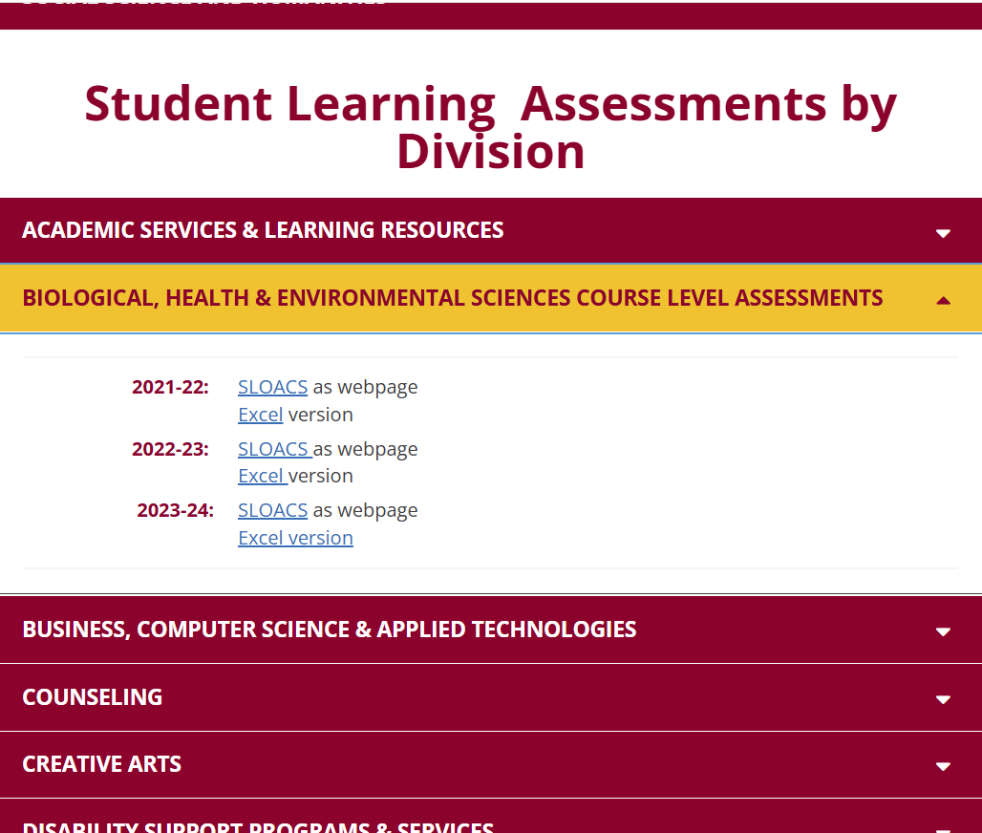
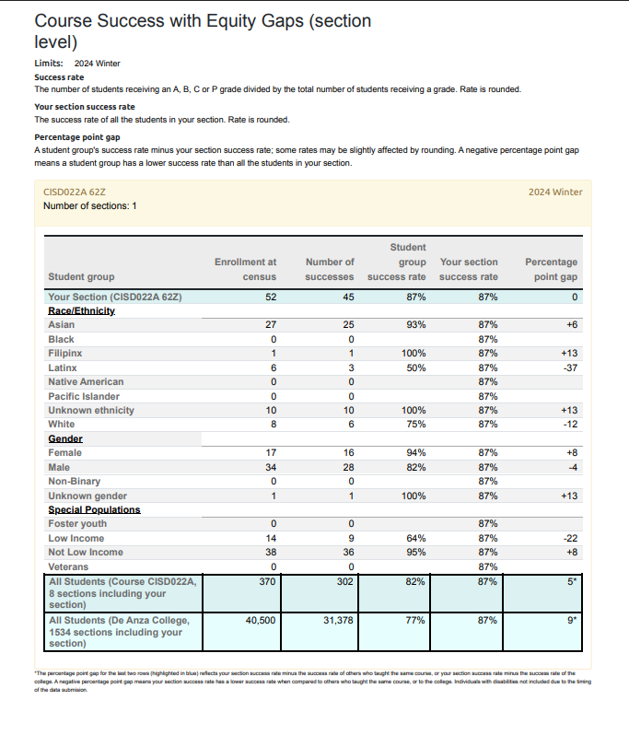
I. Accreditation (cont.)
+

Slide 5
II. Reviewing the Process
Student Learning Outcomes
Course Level (CSLO)
Program Level (PSLO)
Institutional Level (ISLO)
Student Services Learning Outcomes
Administrative Unit Outcomes

Slide 6
Outcome Defined
(Redefined)
Conduct assessments
Summarizing data
Reflection
Enhancement
Plan methods of assessment

Slide 7
Outcome Defined
(Redefined)
Conduct assessments
Summarizing data
Reflection
Enhancement
Plan methods of assessment
Assess each course at least once per revision cycle = once every five years minimum*
*Core courses should be assessed continually

Slide 8
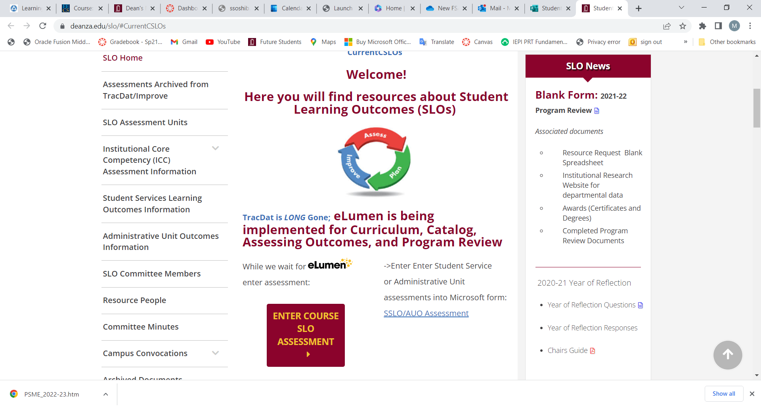
Document the Assessment

Slide 9
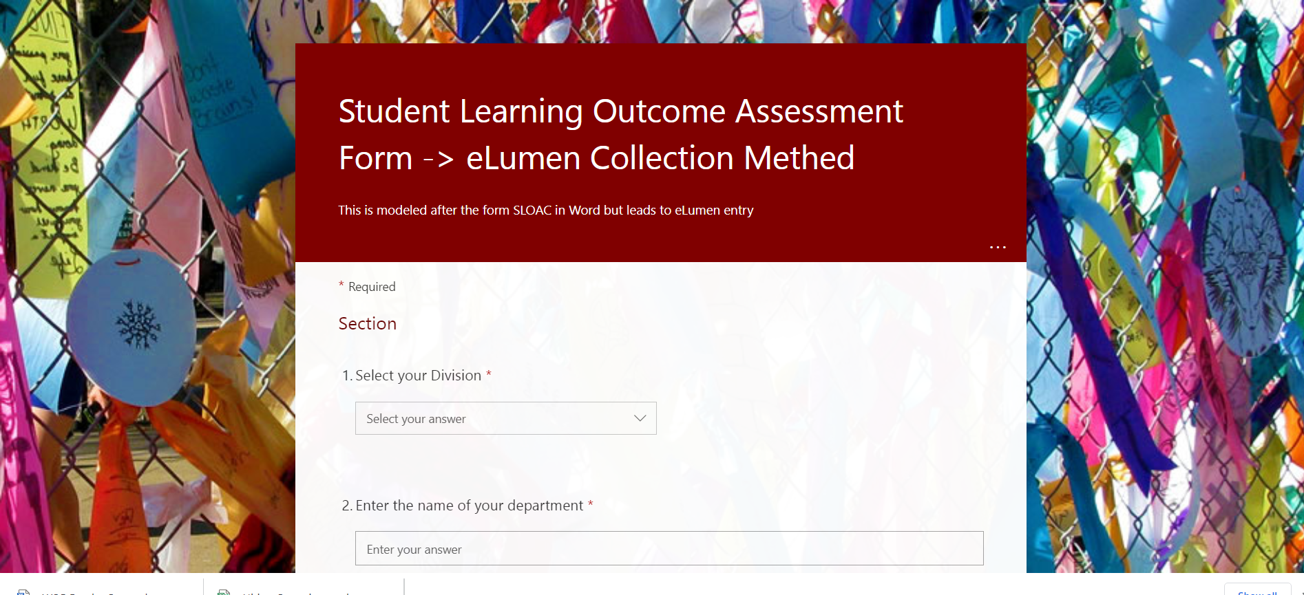

Slide 10
Documenting Your Assessment
Select your Division *
Enter the name of your department *
Enter the name of the course with section. For example, MATH 22-50Z *
Enter CRN# for course *
Enter SLO Statement(s) As it (they) appear on the Course Outline of Record. You may assess one or more at a time. *
Academic Year *
Quarter of Assessment *
Modality of class *
Method of Assessment *
Elaborate on Assessment Method *

Slide 11
Documenting Your Assessment
11. Number of students exceeding expectations
12. Number of students meeting expectations
13. Number of students approaching expectations
14. Number of students who do not meet this/these outcome(s)
15. N/A Not Applicable (withdrew, absent, ...)
16. Reflection *
17. Enhancement/Action *
Or let Canvas do it for you: Canvas & Outcomes Assessments

Slide 12
Mapping
CSLOs to PLOs
CSLOs to ISLOs

Slide 13
Mapping
Critical
thinking
Communication and expression
Design Java programs for the Android platform.
Design mobile applications using object-oriented methodology and advanced Java concepts using Android Development Kit.

Slide 14
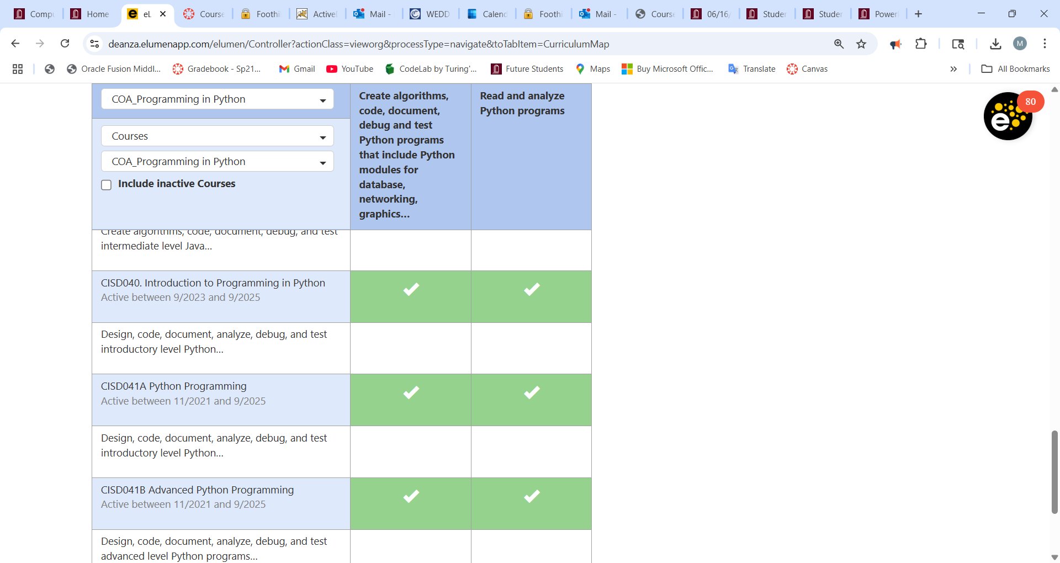
Mapping – Making the connections in eLumen

Slide 15
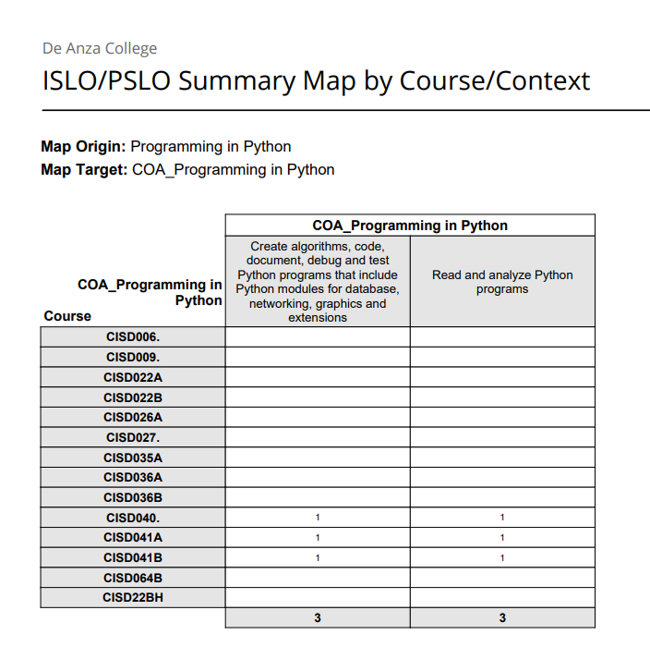
Mapping Report from eLumen

Slide 16
Summary
Must use the Student Learning Outcome verbatim from the Course Outline of Record
Enter Assessment directly into Microsoft form: SLO Course Assessment

